Slide 1
Class 6
Thursday November 19th, 2020

Slide 2
Questions?

Slide 3
Today’s Plan
Review from last class
Verb “to be”
Prepositions

Slide 4
From Last Class

Slide 5
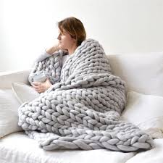
Pronouns that refer to something: it and its
It is big, soft, and warm

Slide 6
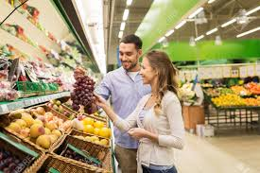
Pronouns that refer to more than one person or thing: their, theirs, they, them
They are in the grocery store

Slide 7
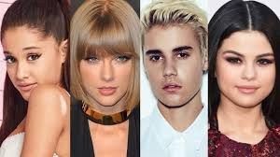
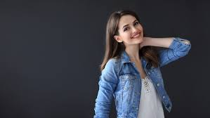
Who?
Who is that girl?
Who is your favorite singer?

Slide 8
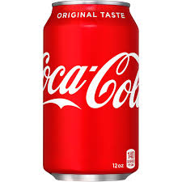
What?
What is that?
It is Coca-Cola
What is your name?

Slide 9
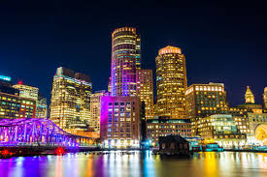
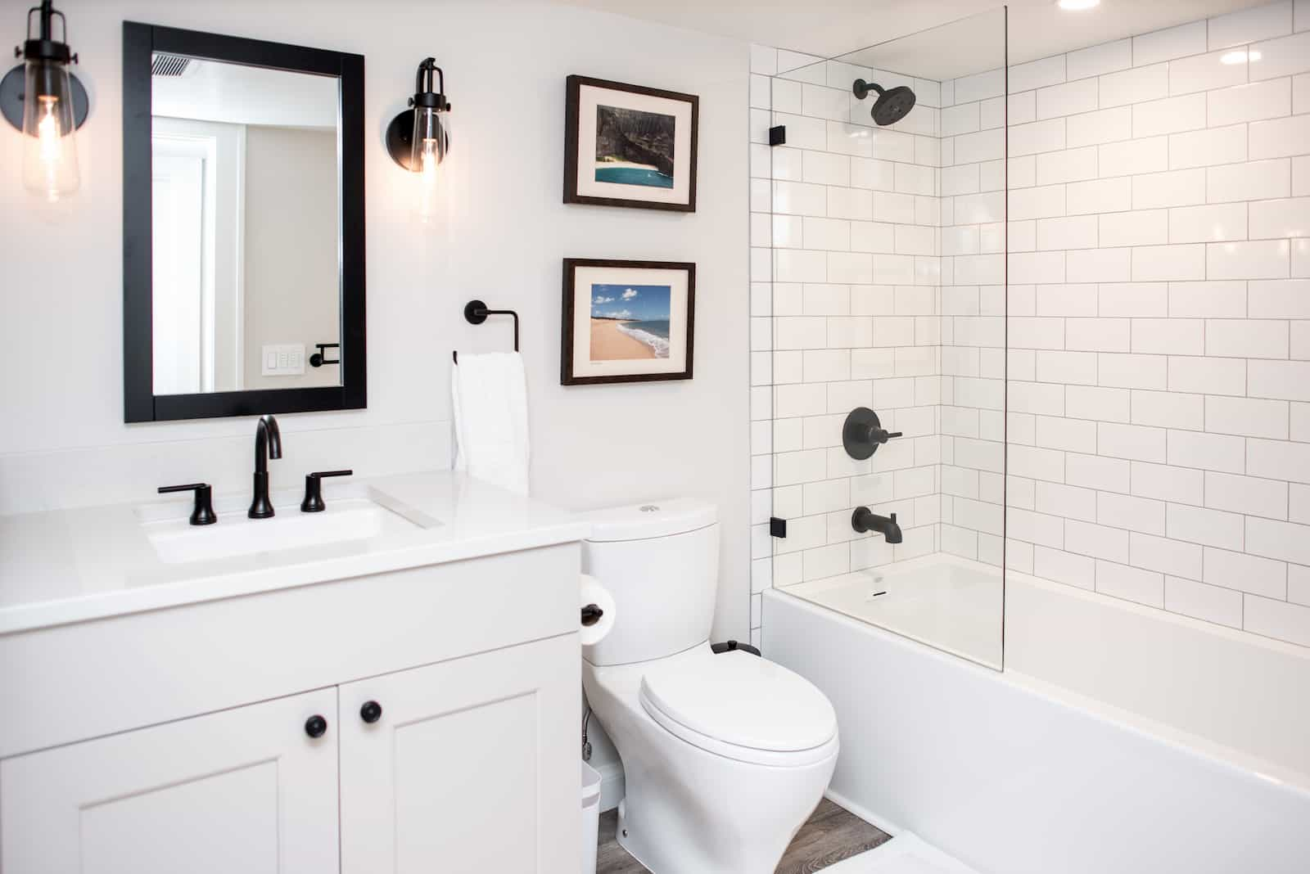
Where?
Where is the bathroom?
Where do you live?

Slide 10
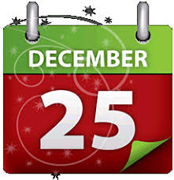

When?
When is your birthday?
When is Christmas?

Slide 11

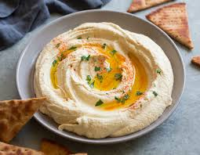
Why?
Why do you like hummus?
Why are you sad?

Slide 12
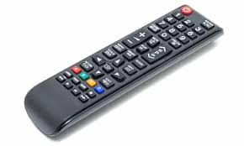
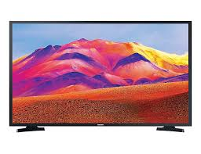

How?
How are you?
How do I turn on the TV?

Slide 13
To be

Slide 14
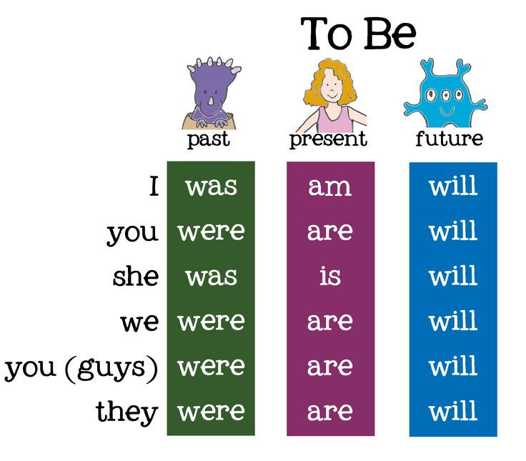

Slide 15
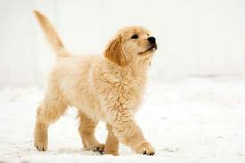
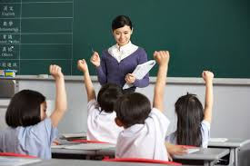
Examples (I)
I was 7 when I got a dog (past)
I am a student (present)
I will be a teacher after I finish school (future)

Slide 16
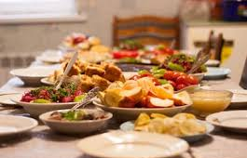

Examples (you)
You were 15 years old last year (past)
You are funny and make me laugh (present)
You will be at dinner at 7pm tonight (future)

Slide 17
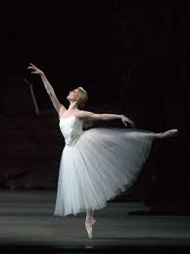
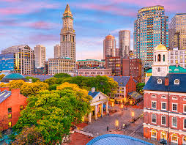
Examples (she)
She was a dancer when she was 10 (past)
She is Emily (present)
She will move to Boston in the spring (future)

Slide 18
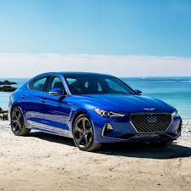
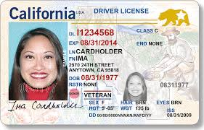
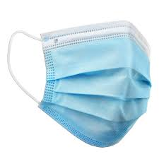
Examples (we)
We were 16 when we got our driver’s license (past)
We are from Australia (present)
We will wear our masks when we go to the doctor (future)

Slide 19
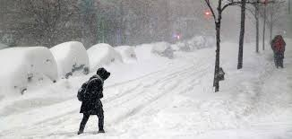
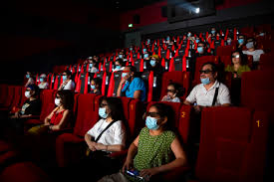
Examples (they)
They were at home when the snow storm happened (past)
They are friends (present)
They will go to the movie theater tonight (future)

Slide 20
Prepositions

Slide 21
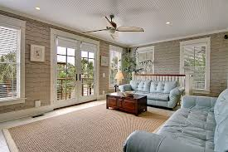
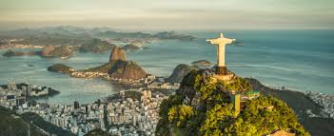
In
I am in the house
In the future, I will go to Brazil
I am going to my class in person

Slide 22
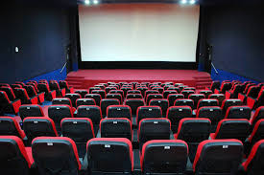
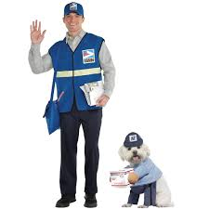
At
We watch movies at the movie theater
We will go to the bar at night
The mailman is at the door

Slide 23
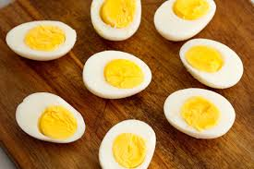
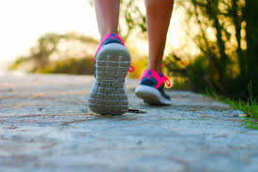
For
We will eat eggs for breakfast
I am going for a walk
I make food for myself to eat

Slide 24
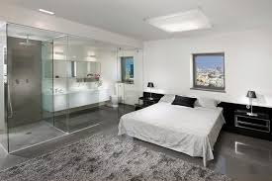
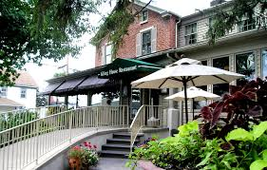
By
The bathroom is by the bedroom
My house is by a restaurant

Slide 25
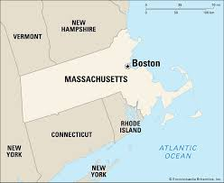
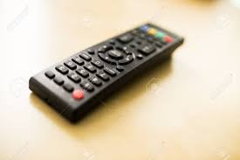
On
The remote is on the table
You can find Boston on a map
My house is on the right side of the street

Slide 26

From
I live 5 minutes from Starbucks
I am from Brazil

Slide 27
See you next time!

